Slide 1
Chapter 6. Natural and Step Responses of RLC Circuits (1)

Slide 2
Contents
Nature Response of a Parallel RLC Circuit
Three Forms of the Nature Response of a Parallel RLC Circuit

Slide 3
Goals
By this lecture, you should be able to:
  Determine the natural response of parallel RLC circuits
  Understand the three forms of the nature response of a parallel PLC circuit

Slide 4
Contents
Nature Response of a Parallel RLC Circuit
Three Forms of the Nature Response of a Parallel RLC Circuit

Slide 5
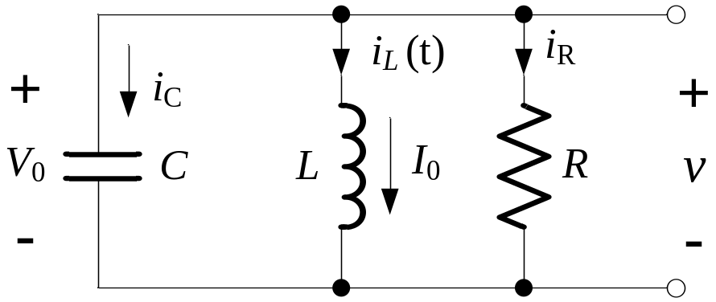
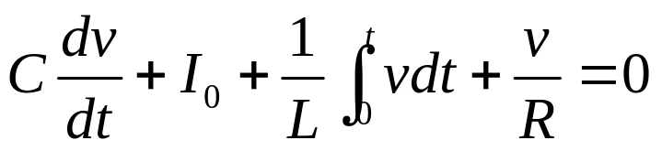
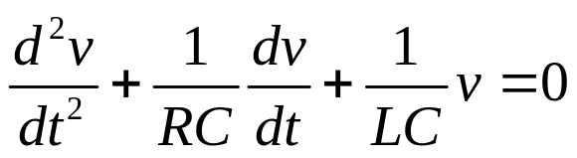
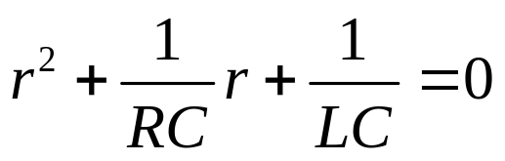
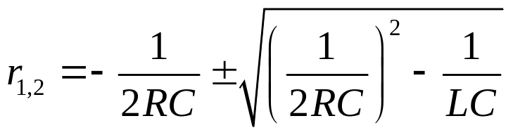
Natural Response of Parallel RLC Circuits
A
Using KCL for node A:
The characteristic equation is:
: Characteristic Roots

Slide 6
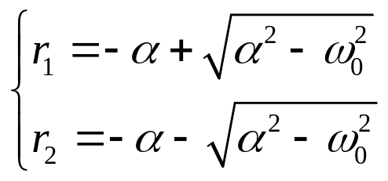





Natural Response of Parallel RLC Circuits
Case 1:
and
are real and distinct:
Over-damped
Case 2:
and
are complex and conj.:
Under-damped
Case 3:
and
are real and equal:
Critically damped

Slide 7
Contents
Nature Response of a Parallel RLC Circuit
Three Forms of the Nature Response of a Parallel RLC Circuit

Slide 8
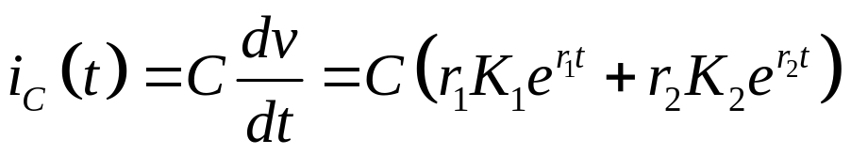
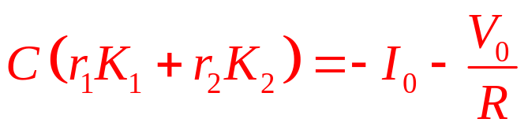
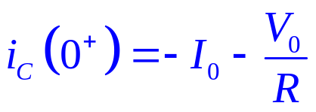
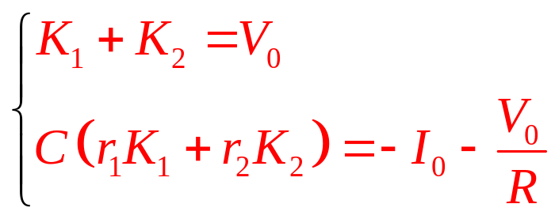


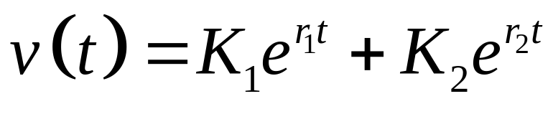
Natural Response of Parallel RLC Circuits
Then we get:
and
are determined
Over-damped response is:

Slide 9
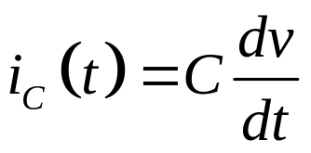
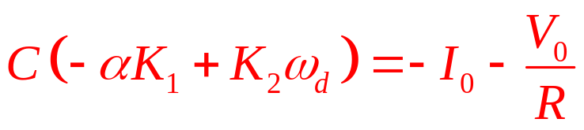
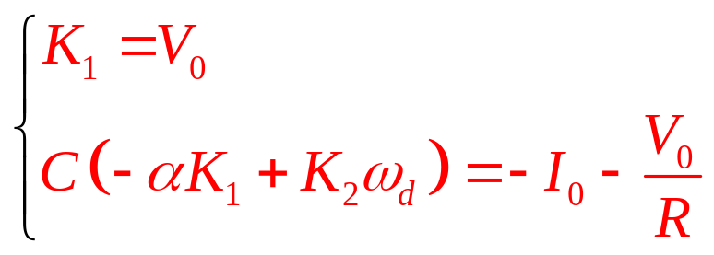
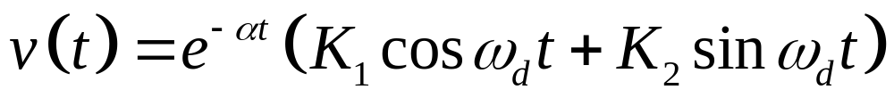
Natural Response of Parallel RLC Circuits
Then we get:
and
are determined
Under-damped response is:

Slide 10
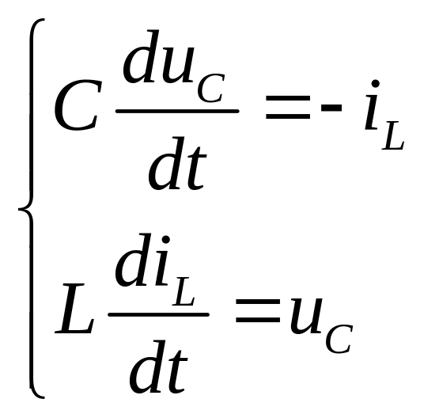
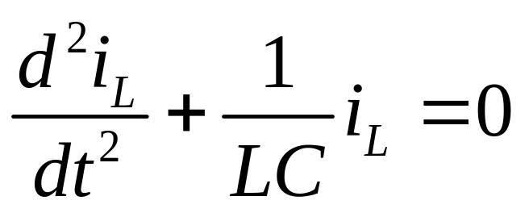
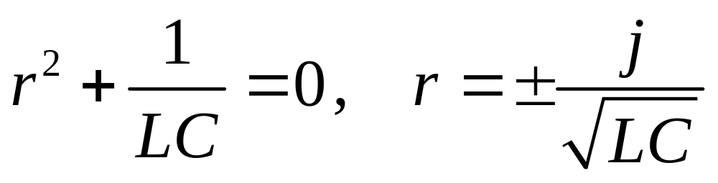
Oscillation in Simple LC Circuit
For the LC circuit, by KCL and KVL:

Slide 11
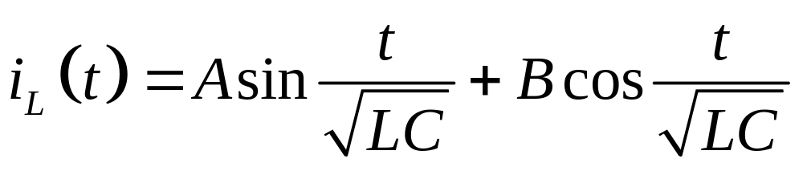
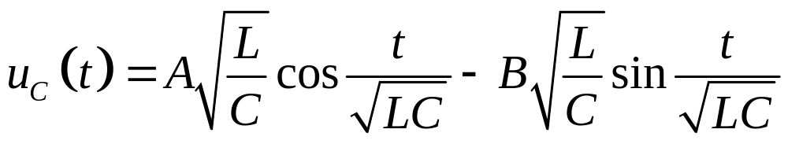
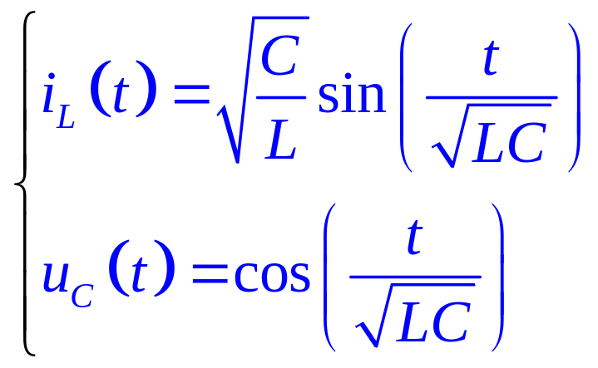
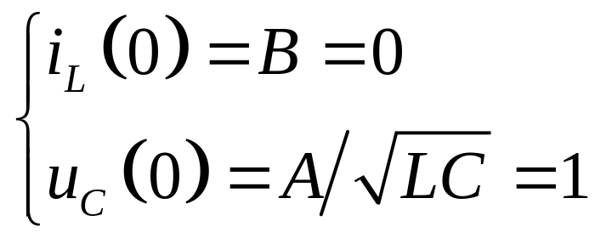
Oscillation in Simple LC Circuit

Slide 12
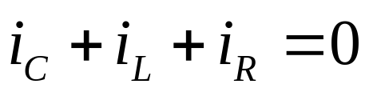
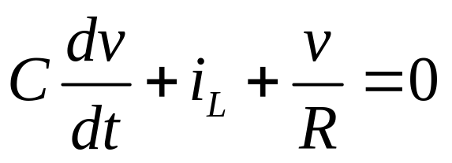
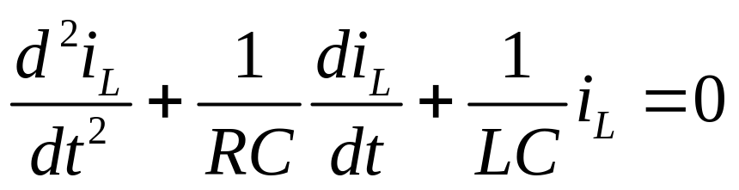
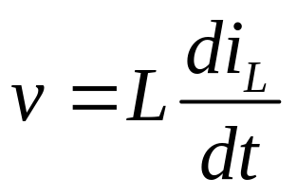
Build Equation by Inductive Current
A
Using KCL for node A:

